Slide 1
Grassland ecosystems

Slide 2
Learning outcomes
know some of the biotic and abiotic factors which produce grassland ecosystems
describe and explain the potential impacts of human actions on grassland ecosystems
appreciate the power and limitations of science when making value judgements and ethical decisions

Slide 3
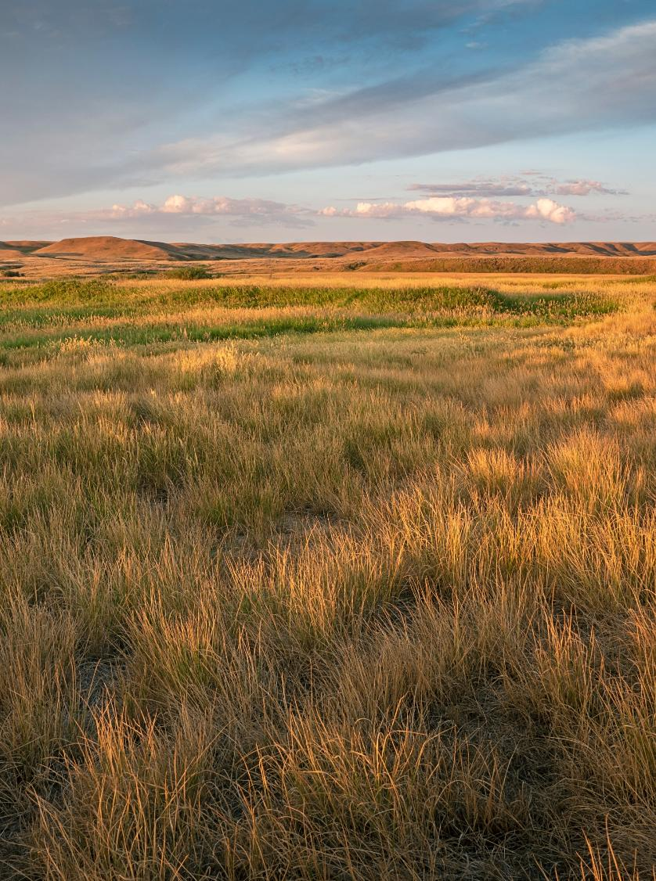
Grassland statistics
Grasslands cover 49% of the land area around the world.
Over 1 billion people rely on grasslands for food and income.
More than 30% of carbon stored on land is stored in grasslands.
Grasslands National Park, Canada
Notes:
Source
Valuing grasslands: Critical ecosystems for nature, climate and people. November 2023. Grasslands, Rangelands, Savannahs and Shrublands (GRaSS) Alliance

Slide 4
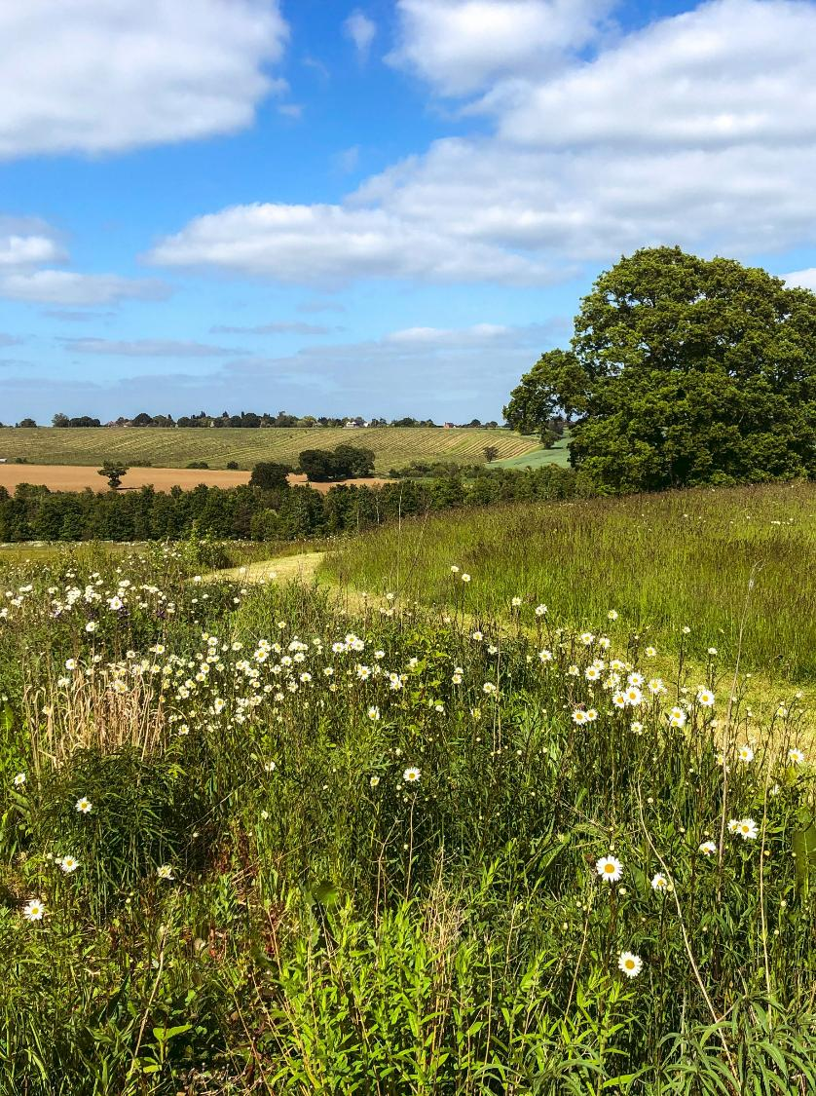
UK Grassland statistics
Semi-natural and improved grassland is 40% of UK land area. ¹
Most carbon stored on land in the UK is stored in grasslands, in part because of the large land area they cover. ²
Grassland habitats are declining in the UK. One of the main drivers of this is changes in agriculture. ³
England countryside, UK
Notes:
Sources
¹ Valuing the Vital: Grassland Ecosystem Services in the UK. June 2023. Plantlife International.
² Carbon storage and sequestration by habitat: a review of the evidence (second edition). October 2021. Natural England.
³ Review of Grassland Trends in the UK. June 2023. Plantlife International.

Slide 5
Abiotic and biotic factors of grasslands

Slide 6
Components of an ecosystem
Abiotic factors - non-living components of an ecosystem
water, elevation, soil chemistry, permeability etc.
Biotic factors - living components of an ecosystem
plants, animals, fungi, bacteria etc.
Process - a series of connected steps or events that have some result or effect. Interactions between the components of an ecosystem
nutrient cycling, water cycling, soil building, erosion etc.

Slide 7
Conditions in grasslands
Grasslands are habitats dominated by grass. This means the conditions and processes in the area support grasses and hinder or prevent the growth of other types of plants.
Abiotic factors can include being too dry or cold to support trees. Hot conditions can also kill young trees, while being tolerated by grasses.
Biotic factors can include large enough populations of grazing animals that shrubs and trees are eaten before they can grow large enough to be established.

Slide 8
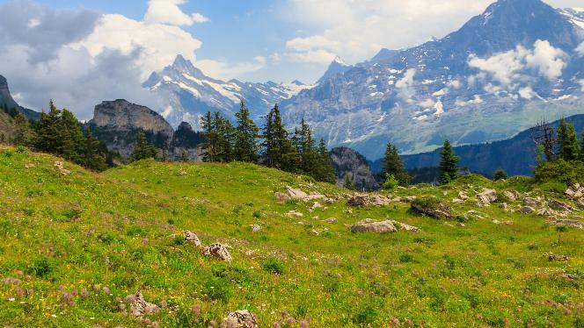
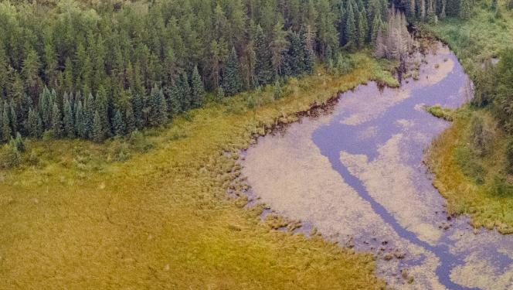
Research types of grassland
Starting suggestions:
alpine grasslands
beaver meadows
What are the combinations of biotic and abiotic components, and processes that cause them to form?
Notes:
To save time, learners could also use the Grassland profiles document and

Slide 9
Processes and interactions in grasslands

Slide 10
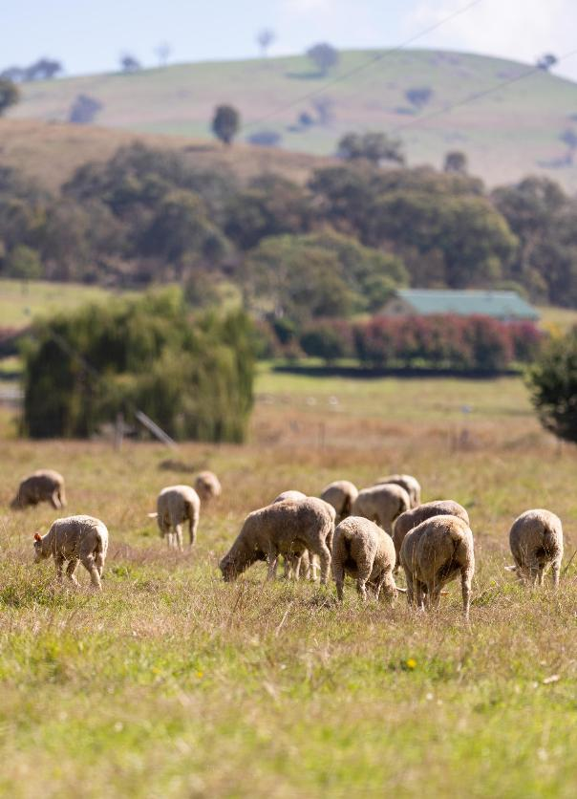
Processes that maintain grasslands
Grazing
Grazing herbivores eat the tops of plants which grow close to the ground.
Grazing maintains grasslands because grasses grow by sending up leaves from just below the ground. The main growing point in most grasses is at or below the soil surface, so they are unlikely to be eaten by grazing.
Many other plants grow from buds at the top or along the stem. Grazing can slow the growth or kill these plants because many of the growing points are eaten.

Slide 11
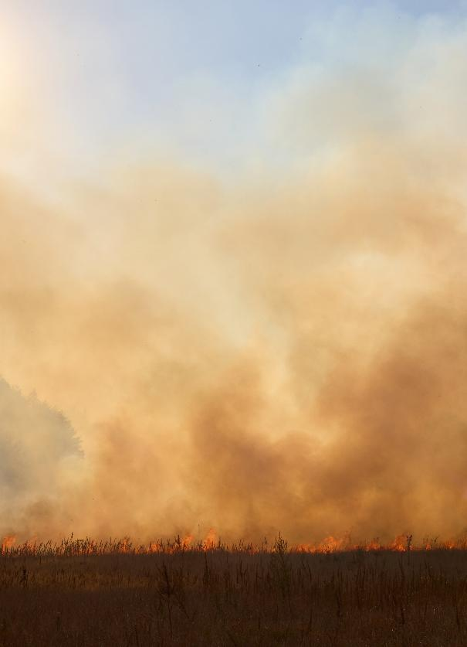
Processes that maintain grasslands
Fire
Lightning and hot, dry conditions can ignite dry plant matter and cause fire.
In grasslands, fires are often hot but short-lived. The heat can kill most parts of plants growing above the soil surface. Grasses generally grow by sending up leaves from just below the ground. This means their growing points are protected while many other plant types are killed. Fires clear space for grasses to spread, while other plants must regrow from seeds.
Notes:
Sources for additional information
Fire and Grazing: the Secret to a Healthy Grassland - Frontiers for young minds - https://kids.frontiersin.org/articles/10.3389/frym.2026.1584825
The ecological benefits of fire – National Geographic Education - https://education.nationalgeographic.org/resource/ecological-benefits-fire/

Slide 12
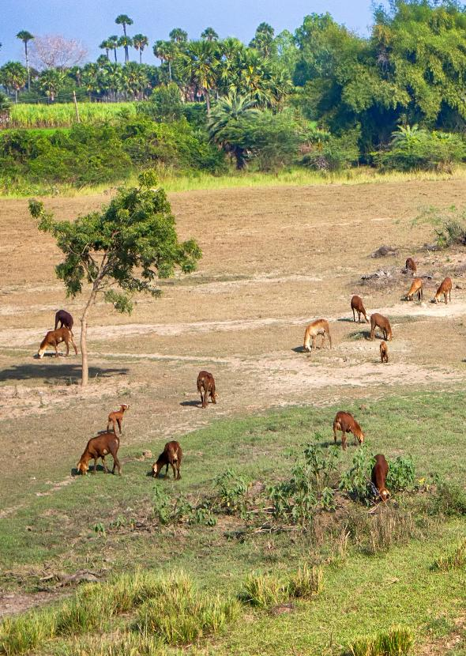
Research how grasslands change
Starting suggestions:
grasslands turning into deserts
grasslands turning into forests
What are the similarities or differences between natural and human-driven processes that drive these changes?
Are there examples of how humans have changed or disrupted ecological processes? What have been the consequences?
Notes:
Good starting points for research
Frontiers for young minds - Cracks in the Earth: Why is East Africa Losing Its Soil?
https://kids.frontiersin.org/articles/10.3389/frym.2026.1751430
Plantlife - Plantlife.org.uk
https://www.plantlife.org.uk/wp-content/uploads/2023/12/Plantlife-WWF-Equilibrium-Research-briefing-grasslands-in-NDCs-NBSAPs-Nov-2023.pdf
Royal Botanic Gardens KEW –
https://www.kew.org/read-and-watch/combating-desertification

Slide 13
Grasslands for people

Slide 14
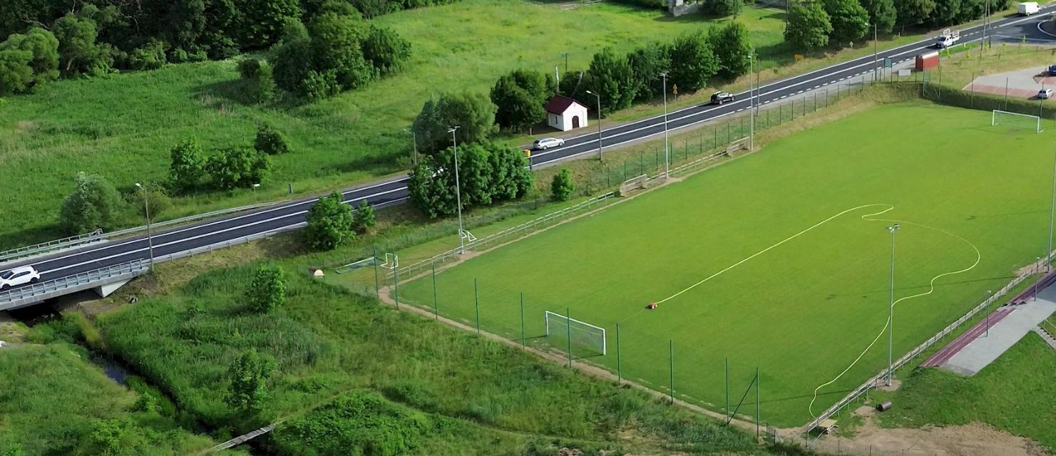
What differences are there between grasslands that were made for people and other grasslands?
Why have humans made this football pitch have these characteristics?
Notes:
Grasslands made for humans are usually:
flatter and smoother
shorter vegetation
fewer plant species
Ball games are more predictable and safer for people on smoother, flatter surfaces.
It is easier to walk through shorter vegetation.
Some people like the look of short, uniform grass lawns.

Slide 15
Comparing human and natural processes
What do humans do to maintain grasslands?
What natural processes are these actions similar to?
What could happen to human-made grasslands without these actions?
Notes:
Possible responses include:
Mowing/cutting – Acts like grazing.
Weeding – Acts like herbivores which specialise in feeding on some species more than others.
Seeding – Acts like seed dispersal, but brings in specifically grass seeds.
Watering – Acts like rain (precipitation). Allows fast growing plants and plants that thrive with more water to continue growing in dry conditions.

Slide 16
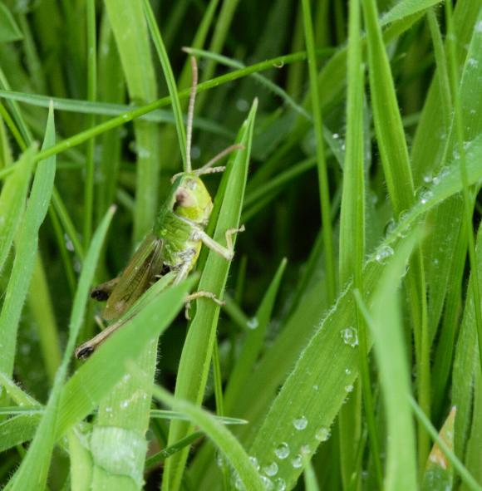
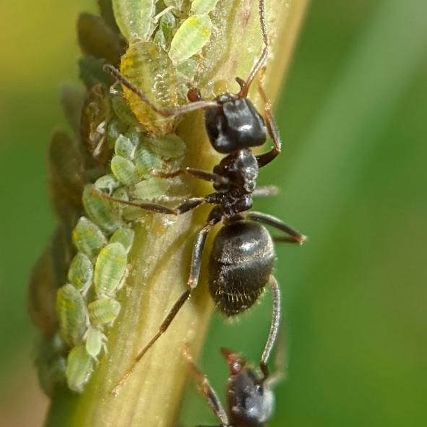
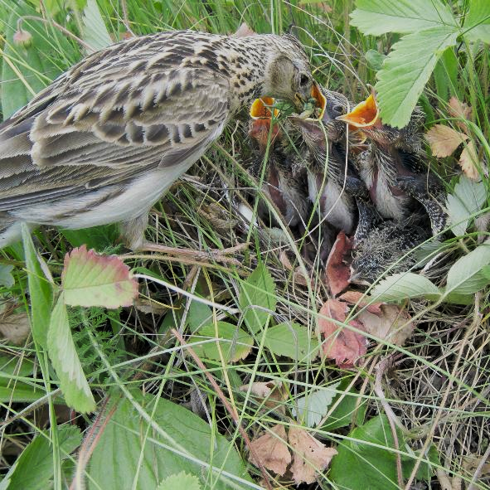
How might wildlife be impacted by the characteristics of grasslands made for people and the processes used to maintain them?
Meadow grasshopper
Black ant
Skylark
eats grass
lays eggs in soil
builds mounds and digs nests
secretions from aphids on tall plants can provide extra food
nests on the ground
feeds young with insects
Notes:
Potential responses could include:
Flat, even surfaces of lawns offer fewer microhabitats and less 3-dimensional structure for living things to shelter in.
Regular watering may affect ground or soil nesting animals, and may allow drought-sensitive plants to survive and outcompete slower-growing, drought-tolerant plants.
Application of chemicals at concentrations that are not harmful to human-sized organisms might be harmful to smaller organisms.
Mowing kills or reduces populations of tall plants and the aphids they support, affecting all the animals that feed on aphids.
More information:
The Living Meadow: How Mowing Affects Insects and Spiders – Frontiers for young minds - https://kids.frontiersin.org/articles/10.3389/frym.2025.1565644

Slide 17
Reflections and extensions

Slide 18
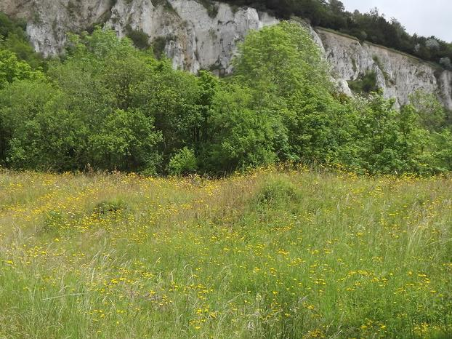
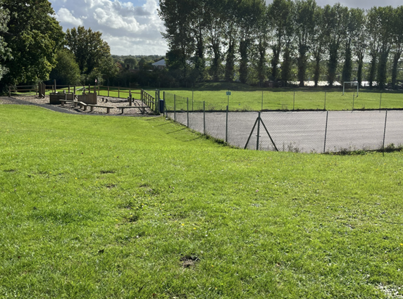
What is the best type of grassland?
Dry chalk grassland
Playing field or lawn
I like playing fields because I like to play football and sit and talk with my friends on them.
© Colin Smith CC BY-SA 2.0
Chalk meadows are the best because they are rare and support lots of animals.
Meadows aren’t good because I walked my dog in one and they got ticks.
Lawns aren’t good because there is no food for bees.
Notes:
Key takeaways from discussions:
different grasslands have different qualities that might better support human-centred activities like ball games or picnics, or the needs of wildlife and plant
it is necessary to be clear about “best for what?”
science can inform decision-making, but it is ultimately up to stakeholders to evaluate the consequences for people and nature of having different types of grassland and make decisions
Strong discussion responses will demonstrate an understanding that different types of grassland will suit different purposes or organisms. Strong responses should also demonstrate understanding that the types of grassland that can form and be maintained in an area depend on the qualities of each site.

Slide 19
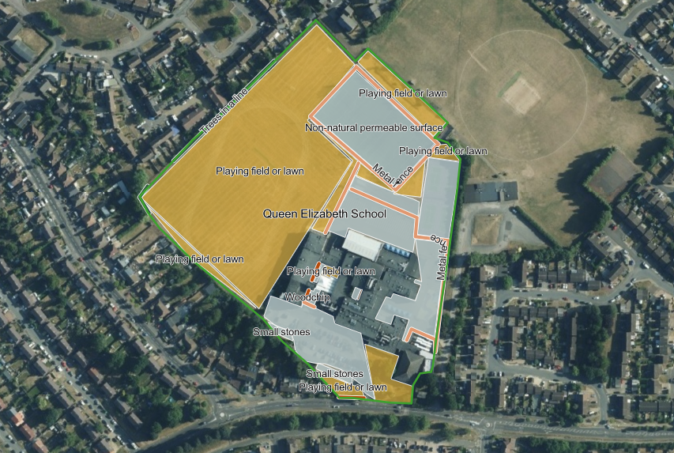
Identifying opportunities
How could we change the characteristics or processes that maintain the grasslands around our school to better meet the needs of our community?
Who and what makes up our school community?
What needs or wants aren’t being met?
Are there areas maintained for people that aren’t being used by people?
Are there areas that don’t meet the needs of people or nature?
Replace with a map of your site

